Slide 1

<CLAWDE.IA> – Law as Code
From article to algorithm –
Can we use LLMs to transform legal texts into machine-executable code?

Slide 2
Team
Why? / Problem statement
Why? - Law as Code as a solution?
Definition
Objective
Selected Law
Process
Results / Output 1 & 2 (+ Demos)
Outlook

Slide 3







Team
Challenge Owner
Walid S. Ahmed
Jurist
Metkel Yosief
Tech
Mariana Alves
Tech
Benjamin Arfa
Juristin
Lirjona Dërmaku
SME
Christophe Koller
Tech
Leo Sinelnikov
Notes:
Divers, mehrsprachig, sympathisch

Slide 4
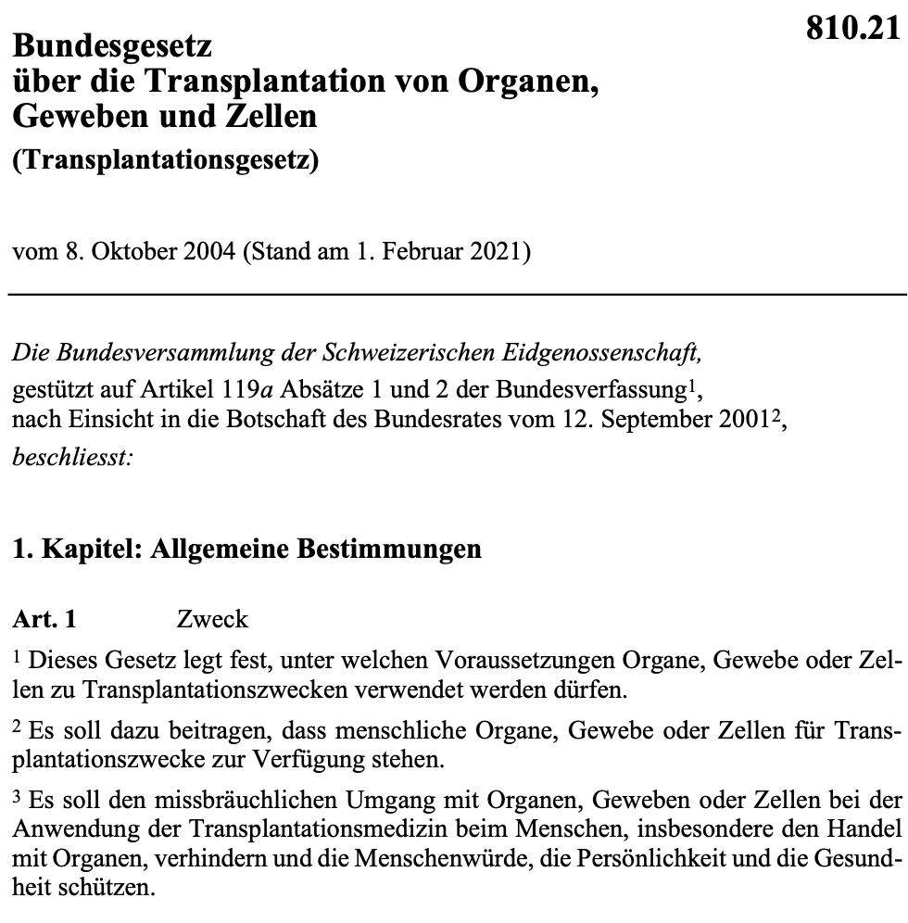

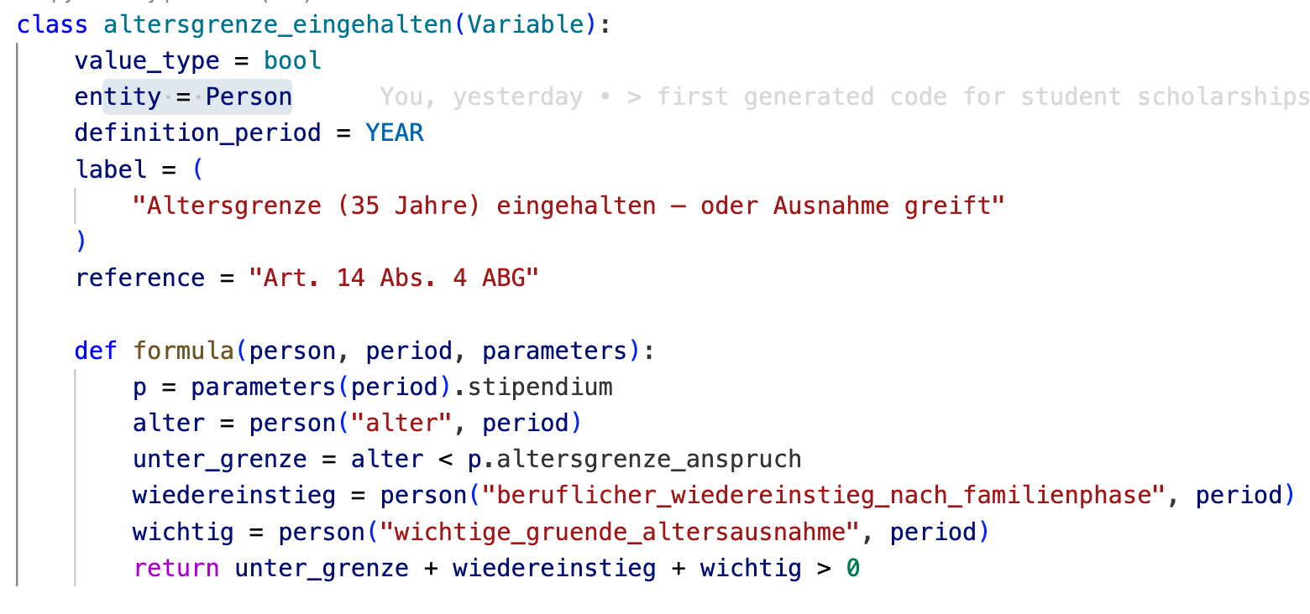
WHY?
Rules of law are hard to understand and expensive to implement
Humans trying to understand and apply laws:
Rules and logic on a specific topic are scattered around different legal texts:
Law, ordinance, jurisprudence, explanatory texts, doctrines, legal commentaries, …
References and definitions sometimes only implicit.
Federal + multiple cantonal legal systems (federalism)
Laws are (constantly) changing
Digital system implementing (legal) rules:
Needs experts to translate legal texts into code
Expensive, hard to validate, decentralized implementations
Rules not implemented using standards
→ Rules of law are not easily and ubiquitous understandable and applicable for the public.
$$$

Slide 5
WHY Law as Code?
Law as Code as a solution?
What if …?
… anybody could easily describe their specific situation and will easily find out what rights and benefits apply?
… administrations can easily and cost effectively build systems with executable and validatable legal rules inside, and provide more systems to the public to check the application of complicated laws to their specific situation?
Solution: Law as Code or Rules as Code (RaC)!
Definition : Law as Code (LaC) or Rules as Code (RaC) is the idea of expressing or translating existing legislation, regulation or policy into machine-executable code, enabling automated and consistent application of legal rules.
… by the way – Rules as Code already exists everywhere …

Slide 6
WHY Law as Code?
Benefits of Law as Code
Traceability of logic to the articles.
Equal treatment at scale
Impact assessment before enactment: Thousands of real-world cases can be simulated before parliament votes. Who gains? Who loses? Where are the unintended hardships?
Low-threshold access to rights e. g. public online …:
… navigators → Which laws apply?
… decision prognostics → Is it worth to ask/apply for X?
… calculators → What is my financial duty or entitlement?
… compliance checks → Did I/my company follow the rules?

Slide 7
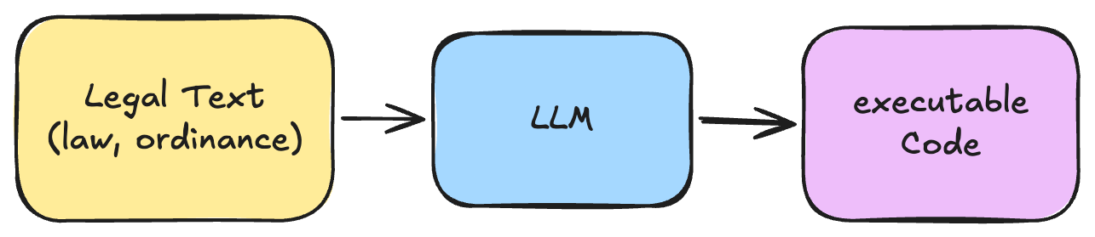
Challenge Hypothesis / Objective
Can we use state-of-the-art Large Language Models (LLMs) to automatically transform legal rules from natural language Swiss law into verifiable, machine-executable code?
deterministic
propabilistic

Slide 8
Our Challenge Objectives
Generate code and test data
Validate code by legal experts
Execute code with test data and validate against human coded application (webform from canton Berne)

Slide 9

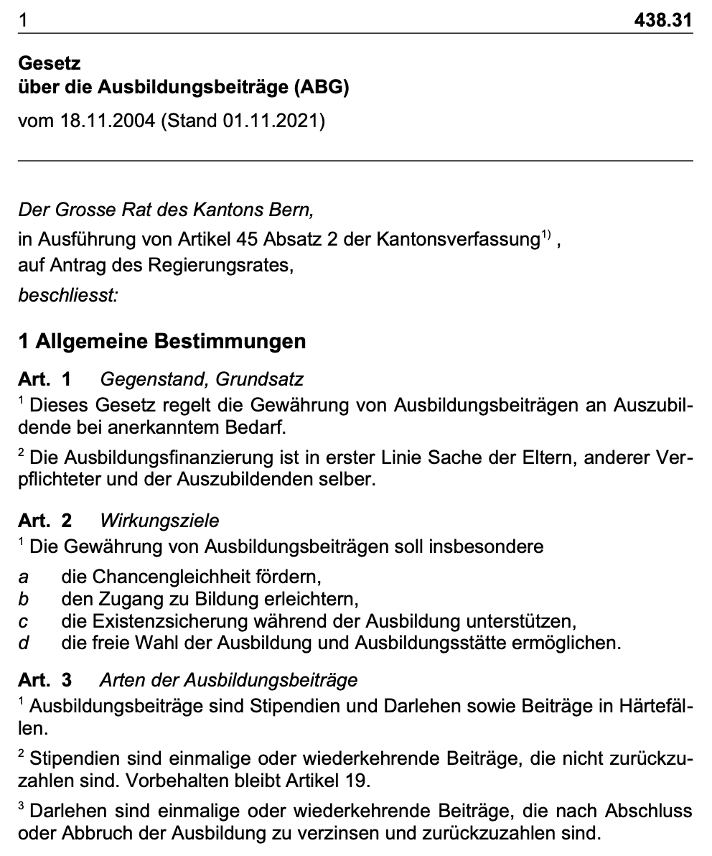
Selected Law Texts for our “litmus test”
To prove our hypothesis, we choose the following law texts:
ABG (Ausbildungsbeiträge Bern — Cantonal)
ABG Art. 1-16 — Stipendium Eligibility
ABG Art. 10/16 — Stipendium Amount
AHVG (Federal Old-Age Insurance)
Art. 3 — AHV Insurance Obligation
Art. 5 — AHV Employee Contribution
Art. 10 — AHV Self-Employed Contribution
OR (Obligation Recht)
Art. 41 — Tort Liability

Slide 10
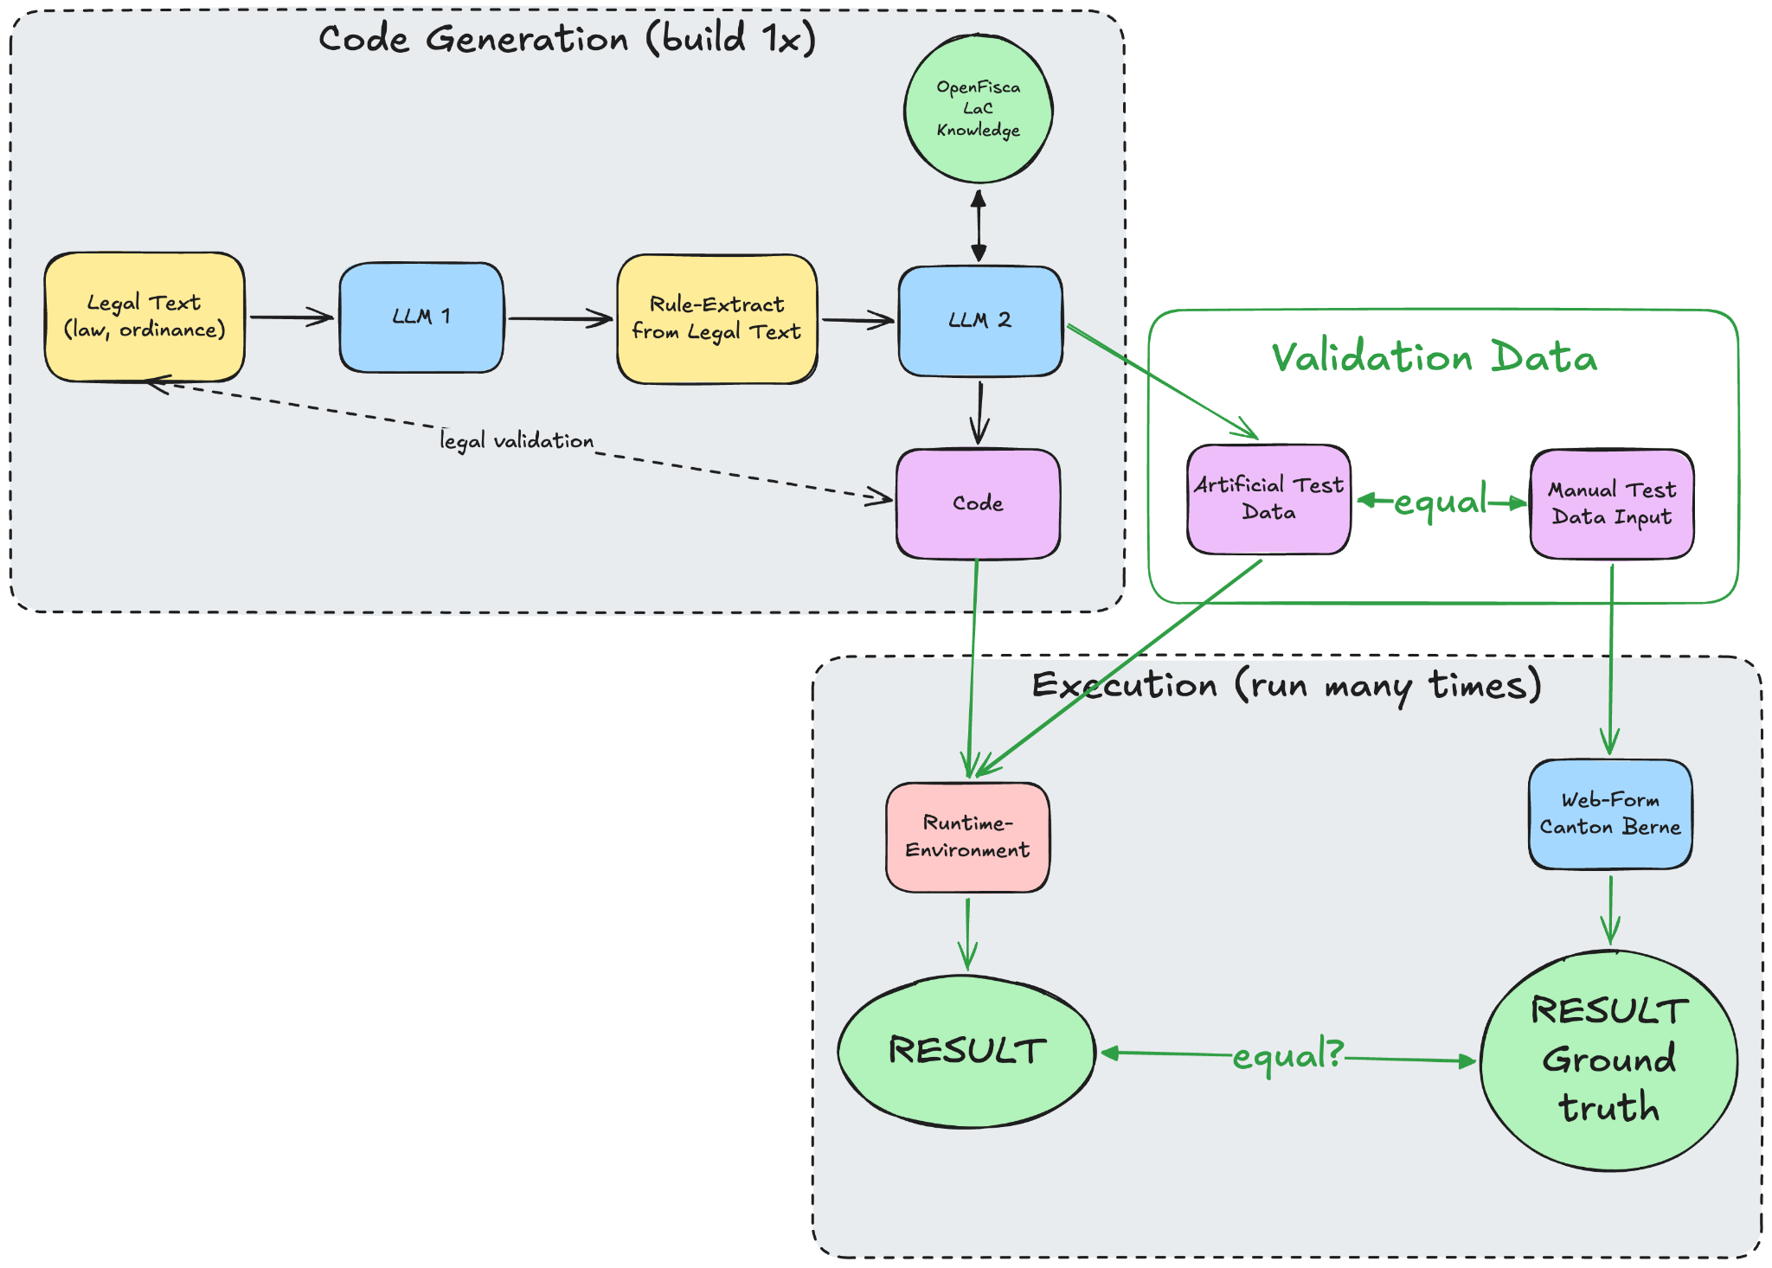
The Process: Code generation and validation

Slide 11
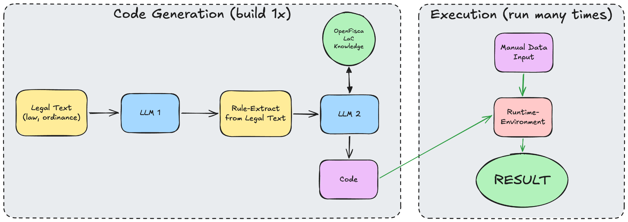
The Process – Phase 2: Execution and application

Slide 12
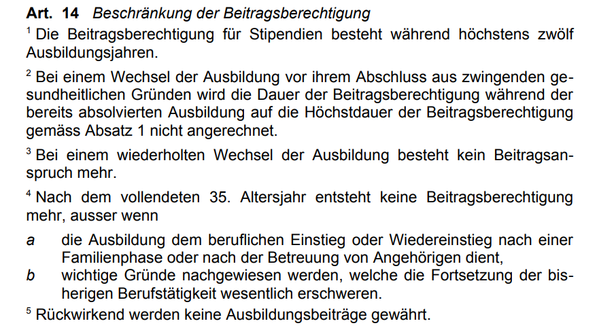
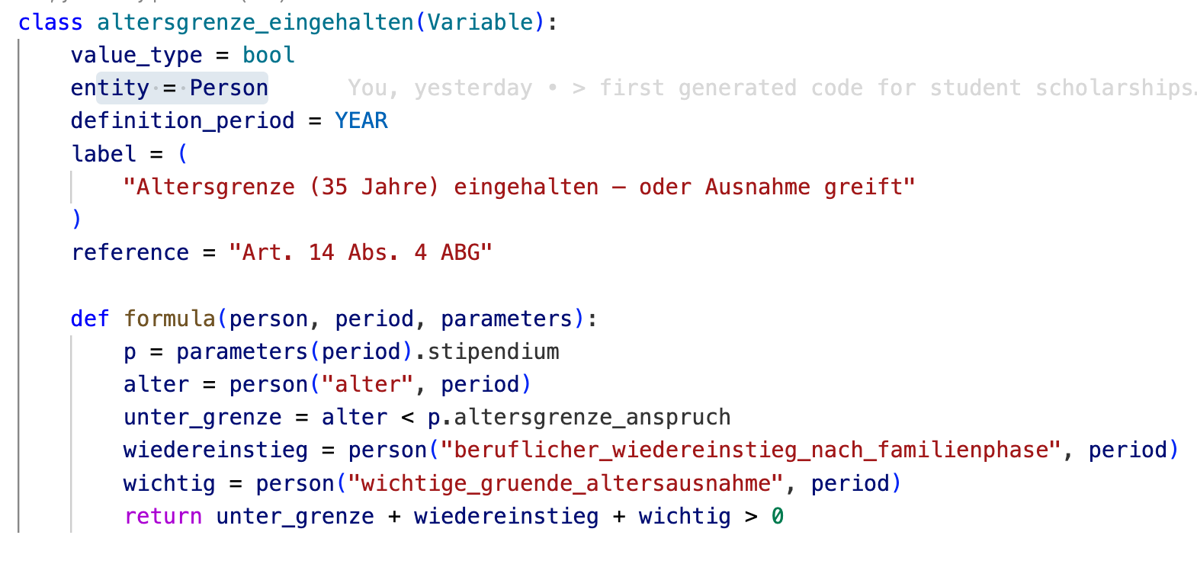

Results

Slide 13
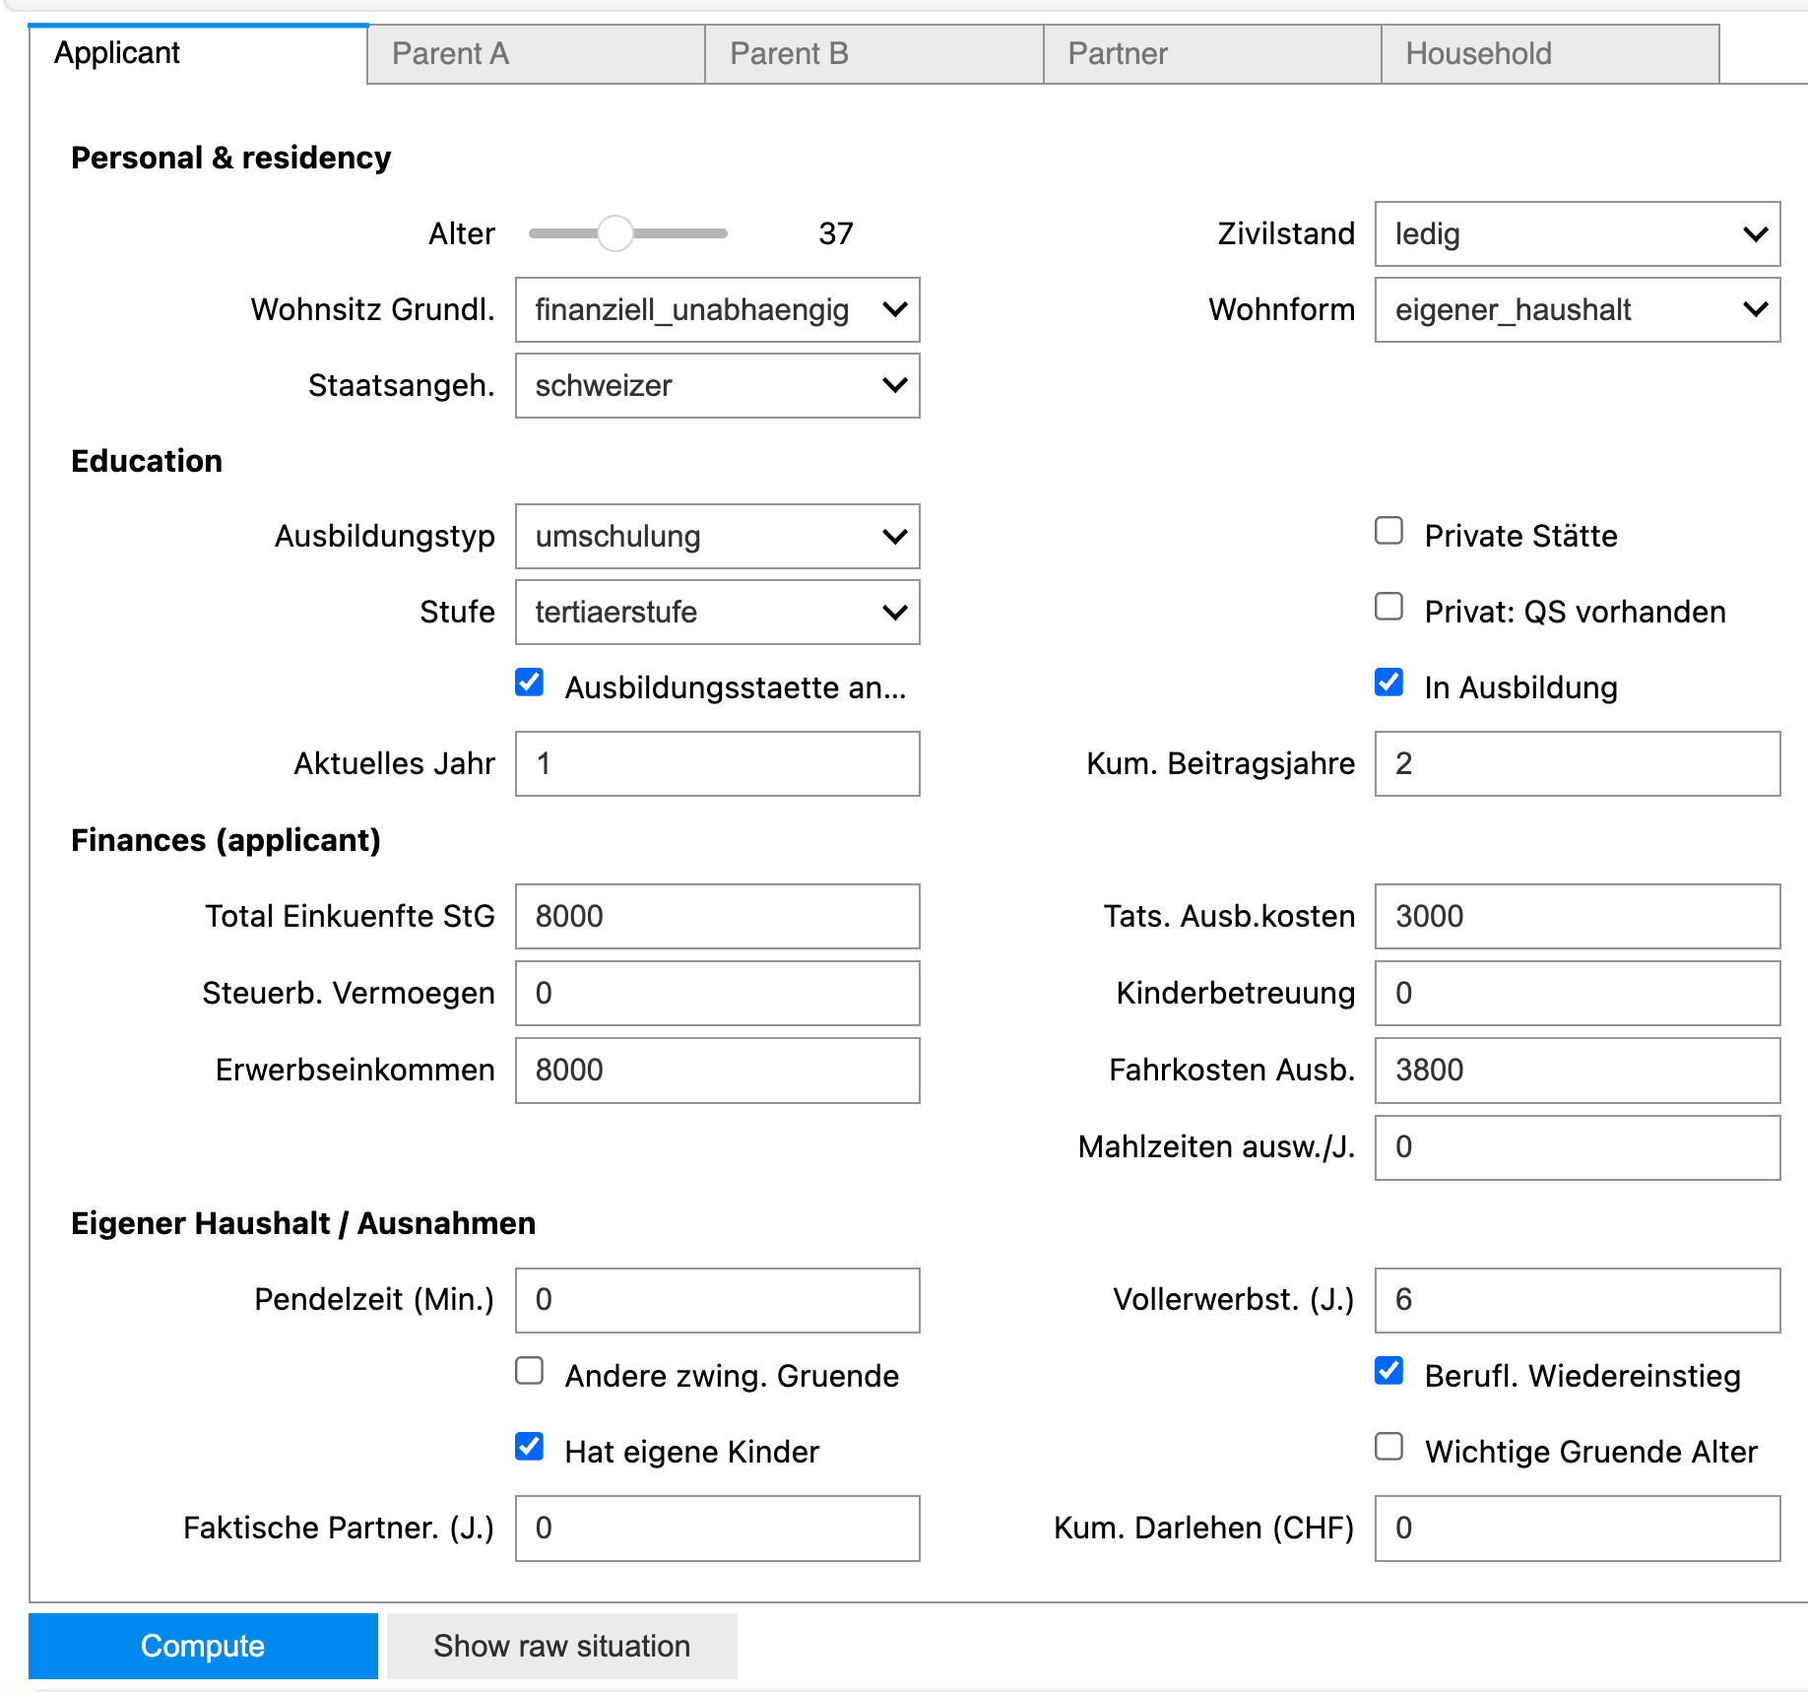
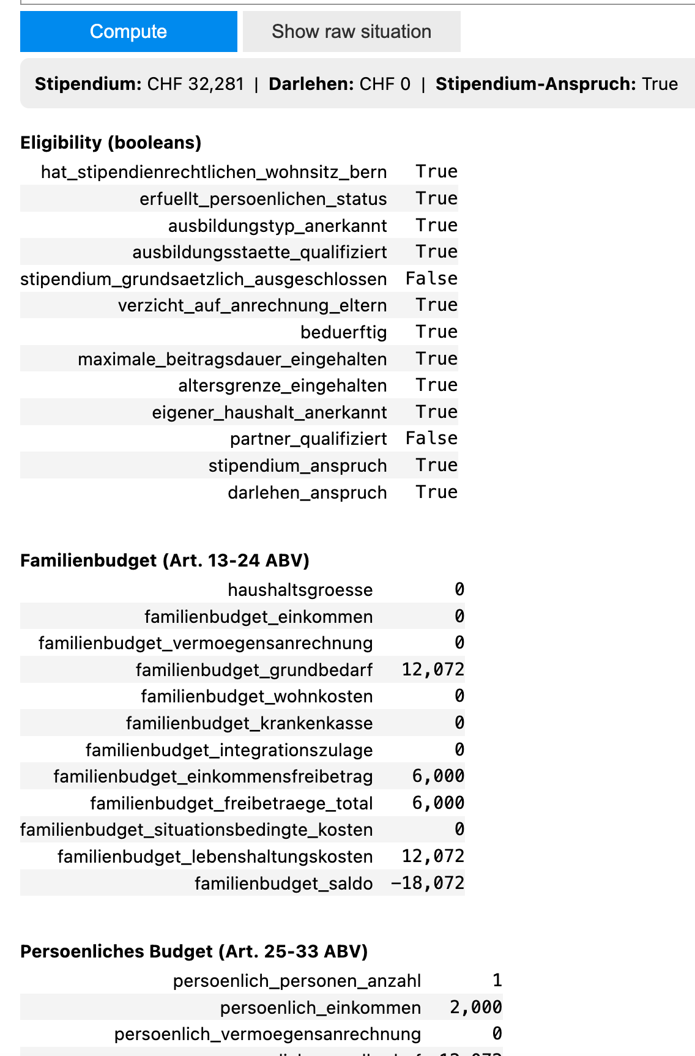
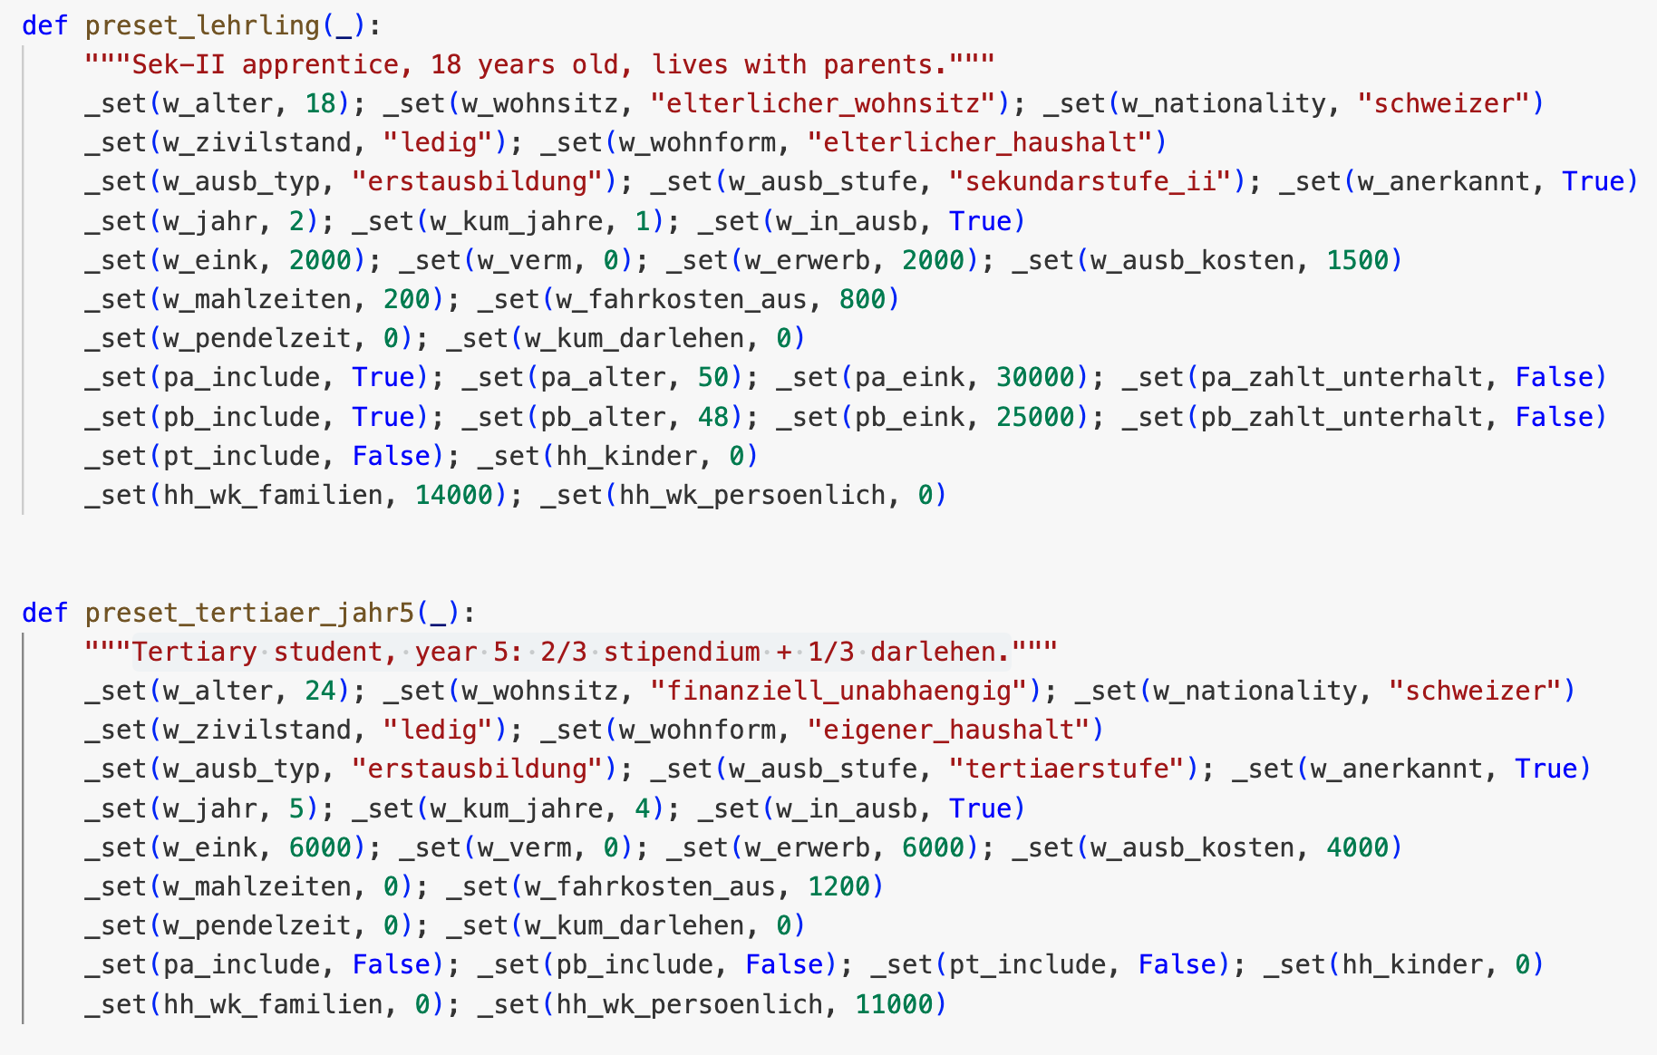
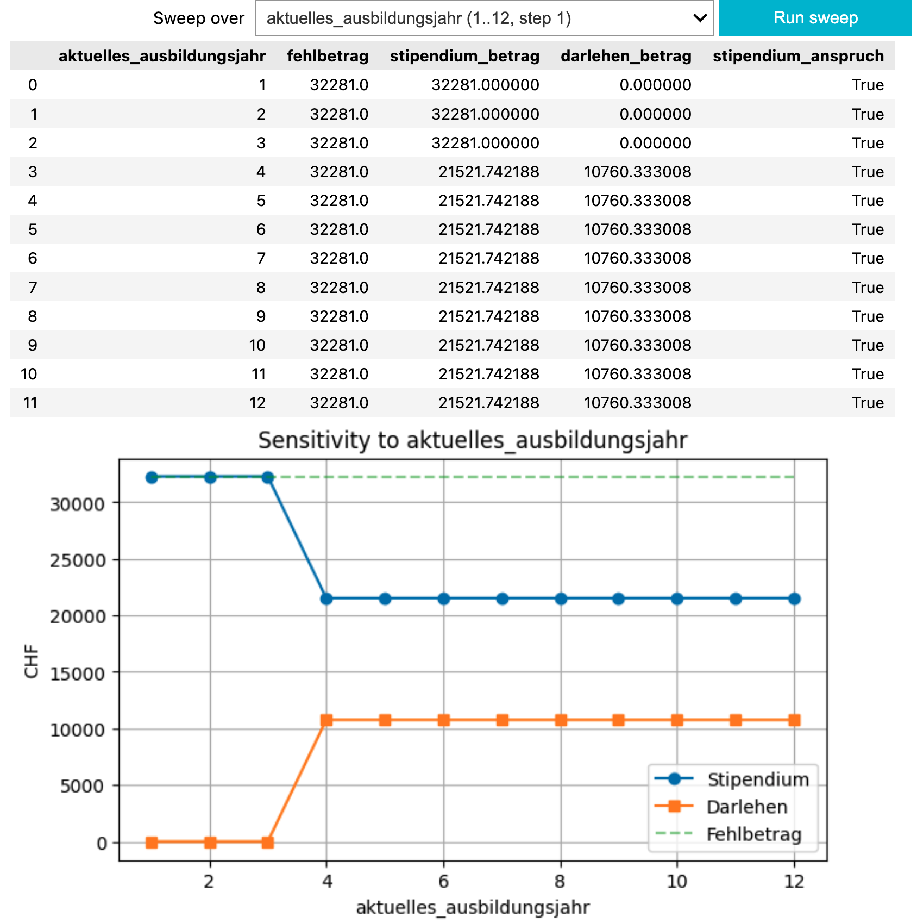
Results: Output 1 and DEMO

Slide 14

Our primary Objectives - ACHIEVED!!!
Generate code and test data ✅
Validate code by legal experts ✅
Execute code with test data and validate against human coded application (webform from canton Berne) ✅

Slide 15
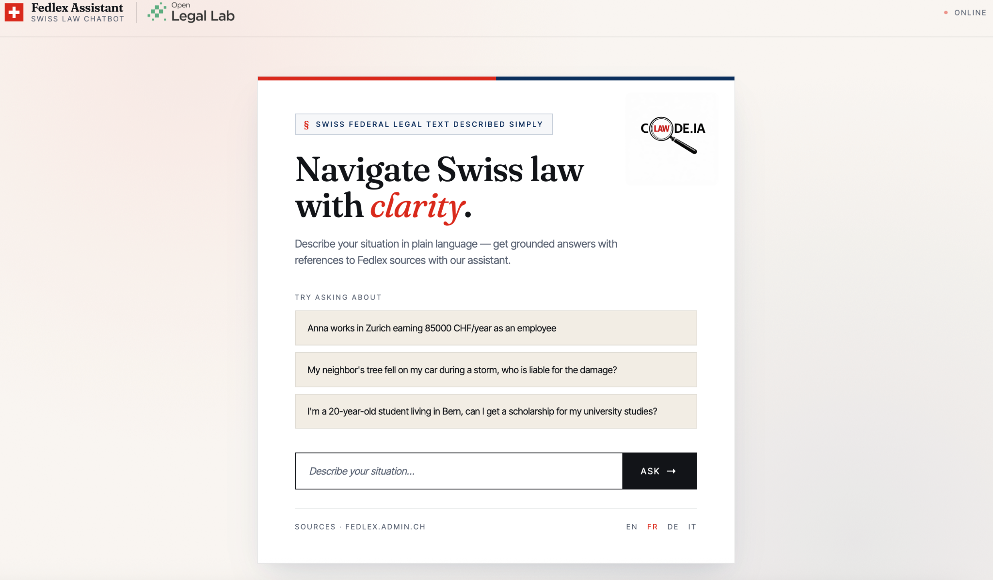
Output 2: Chatbot Interface to navigate Swiss law

Slide 16

Demo
Notes:
Demo of chatbot

Slide 17
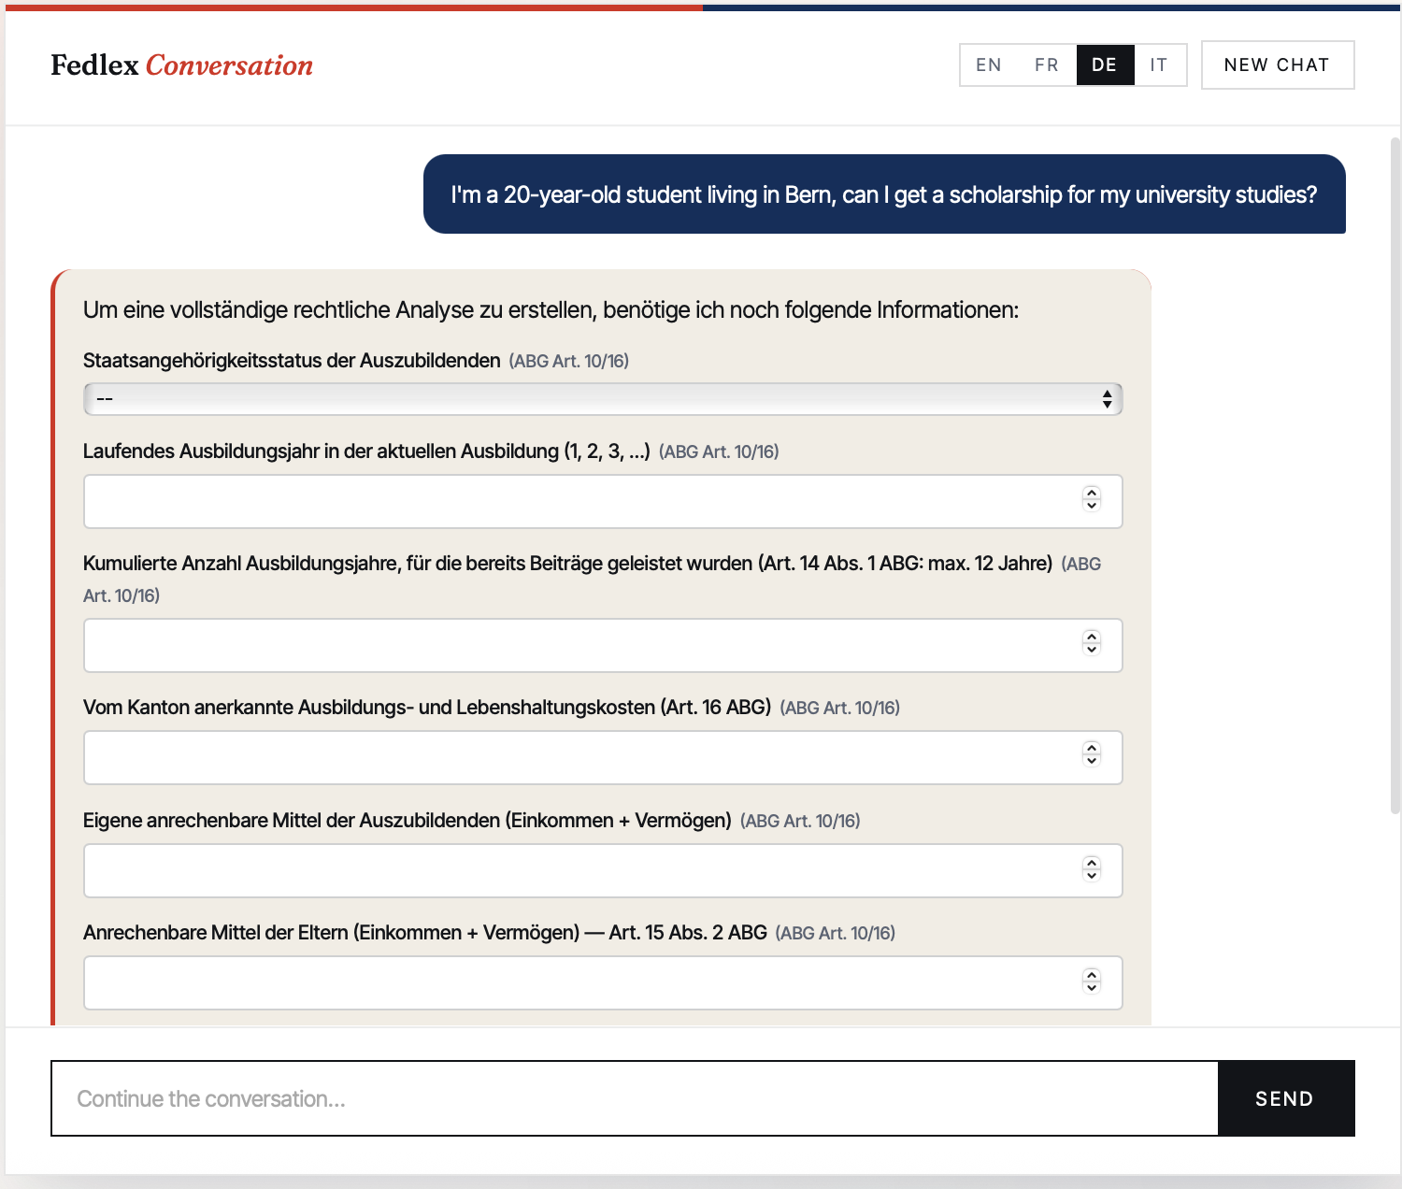
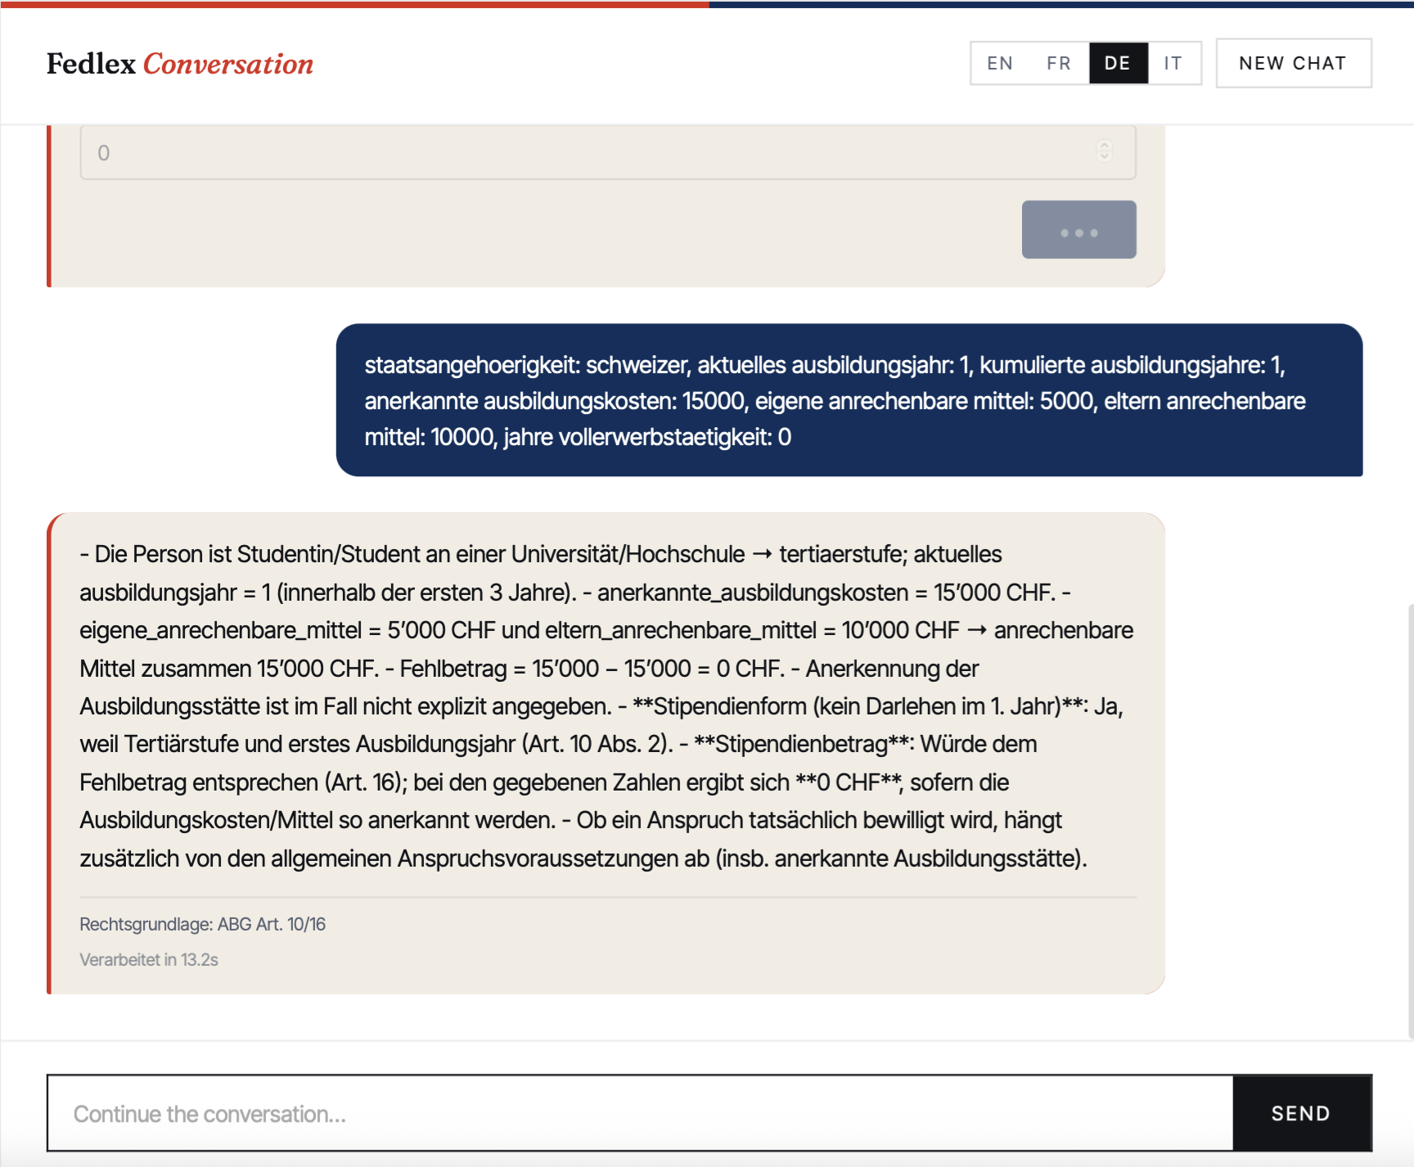
Notes:
If demo video doesn’t load

Slide 18
Outlook and vision for the future
What can be done with automated generation of Law as Code?
For applicants: Replace forms with interactive chatbot-like dialogue/interview:
People could easily describe their specific situation and will easily find out what rights and benefits apply to them!
Administrations can easily and cheaply build systems with legal rules inside, to help people to apply them to their situation?
For people with legal questions: Apply to less “algorithmic” laws to generate “Code of thinking” to be executed by human brains → “Art. 41 OR”
For policy makers: Run large-scale simulations with virtual people to evaluate real-world outcomes (based on statistics) vs. intended outcomes (based on generated simulation data)

Slide 19
LAW AS CODE

